Slide 1
INTERFACING ARDUINO WITH THE BEAGLEBONE BLACK
SUBMITTED BY : AMANDEEP SINGH
STUDENT ID :C0761298
GROUP :2

Slide 2
TABLE OF CONTENT
PROJECT OVERVIEW
REQUIREMENTS FOR INTERFACING
Hardware Requirements
Software Requirements
BRIEF INTRODUCTION OF BEAGLEBONE
Pin Layout
INTRODUCTION TO ARDUINO MEGA
Features
Pin layout
INTERFACING OF ARDUINO MEGA
Schematic layout
Connections of Arduino mega and beaglebone black
Enabling UART ports
Libraries include in coding
Coding
TERMINAL OUTPUT
REFERENCES

Slide 3
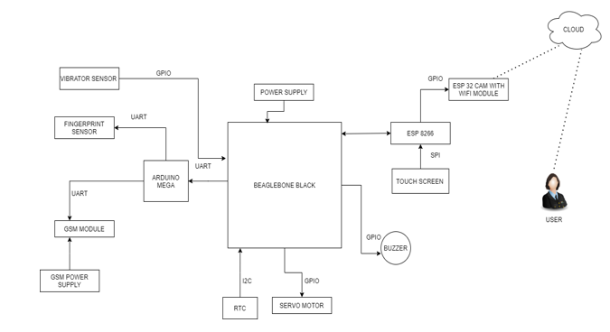
PROJECT OVERVIEW

Slide 4
RECAP
After the successful interfacing of buzzer, Servo motor, Vibration sensor, and Fingerprint sensor, the next task is interfacing of Arduino mega with beaglebone black.
GPIO communications is used for interfacing of buzzer, Servo motor, Vibration sensor except the fingerprint sensor in which UART was used.
For interfacing of Arduino mega with beaglebone black UART communication protocol is used.

Slide 5
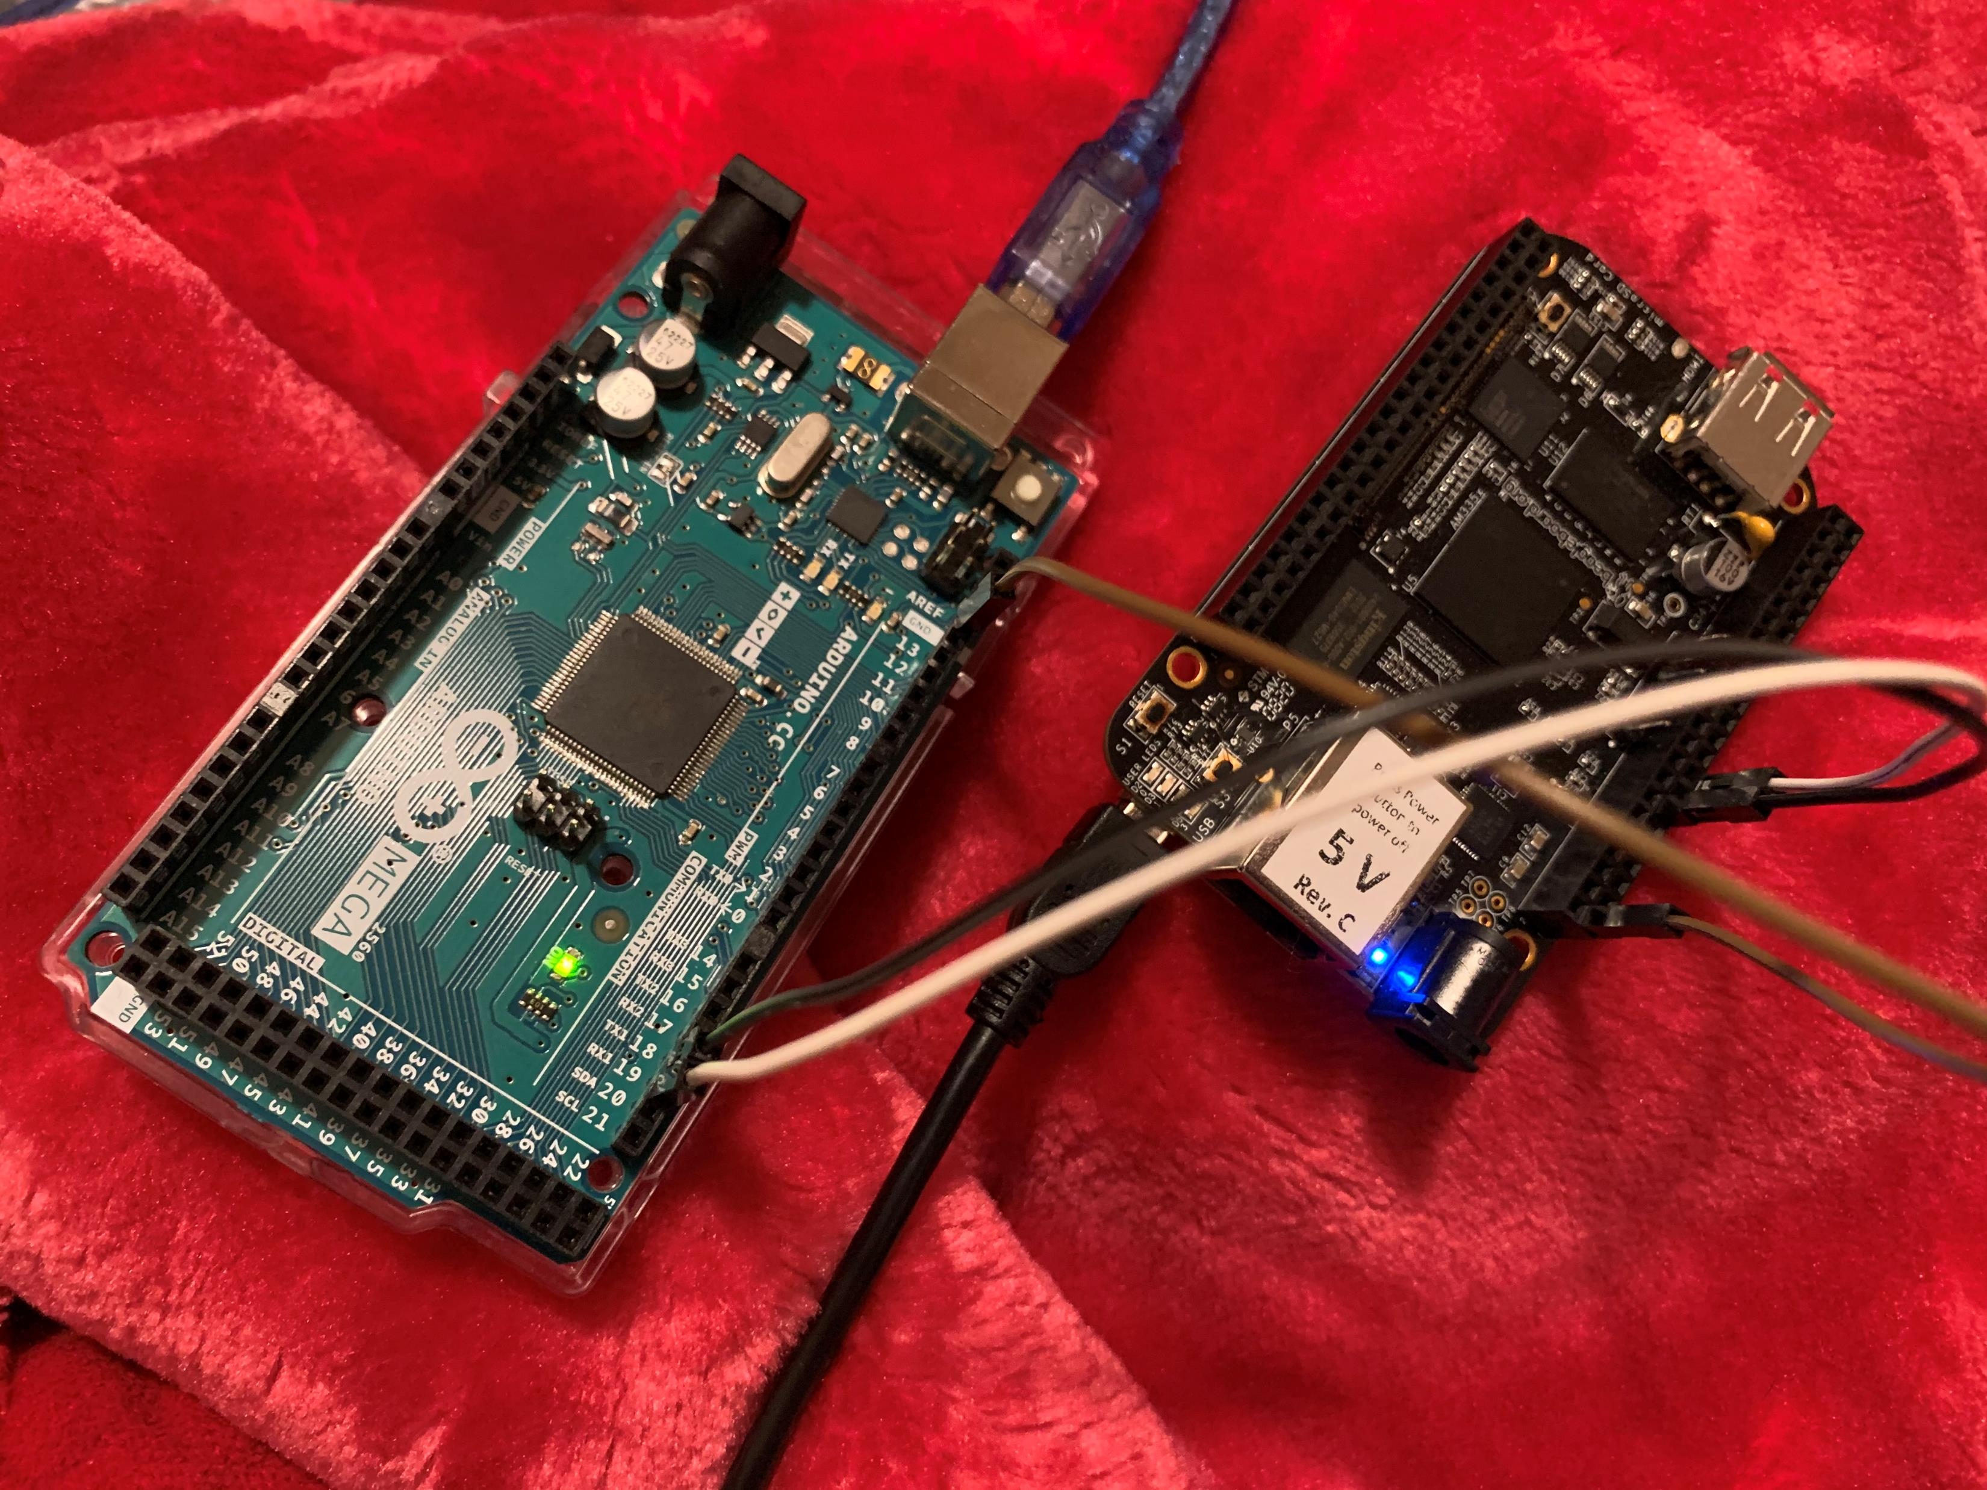
REQUIREMENTS
For interfacing of Arduino mega with beaglebone black there are various hardware and software requirements.

Slide 6
HARDWARE REQUIREMENTS
Arduino mega
Beaglebone Black
Jumper Wires
USB cables to connect beaglebone and Arduino to the host machine.

Slide 7
Software requirements
Arduino IDE
Ubuntu Terminal
GCC Compiler
GNU nano text editor

Slide 8
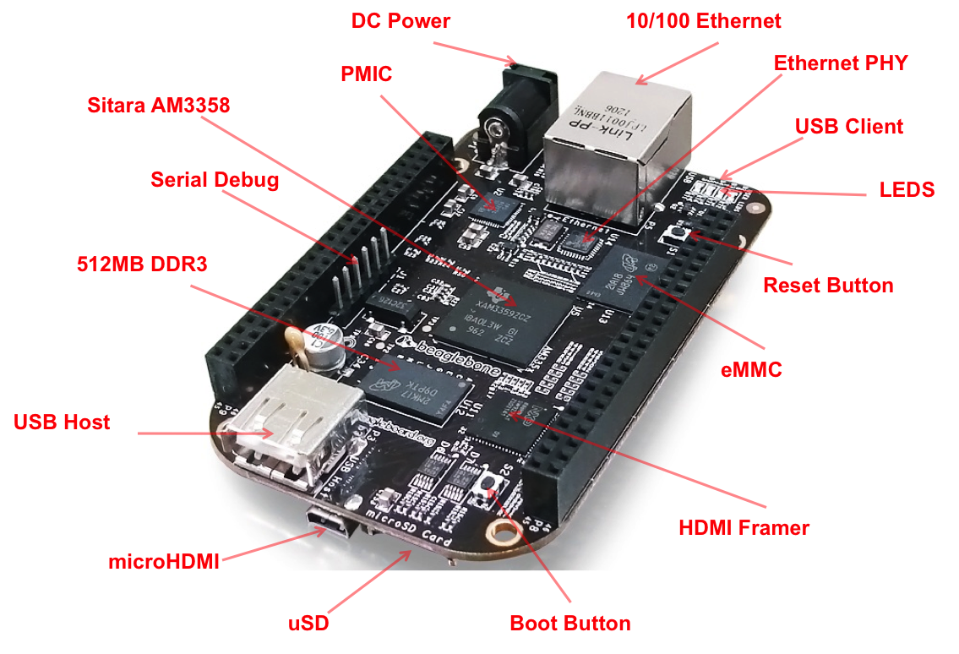
BRIEF INTRODUCTION TO THE BEAGLEBONE BLACK

Slide 9
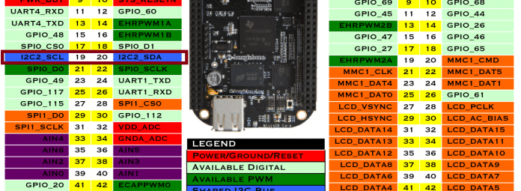
PIN DISCRIPTION
These are the pins that are used for interfacing.

Slide 10
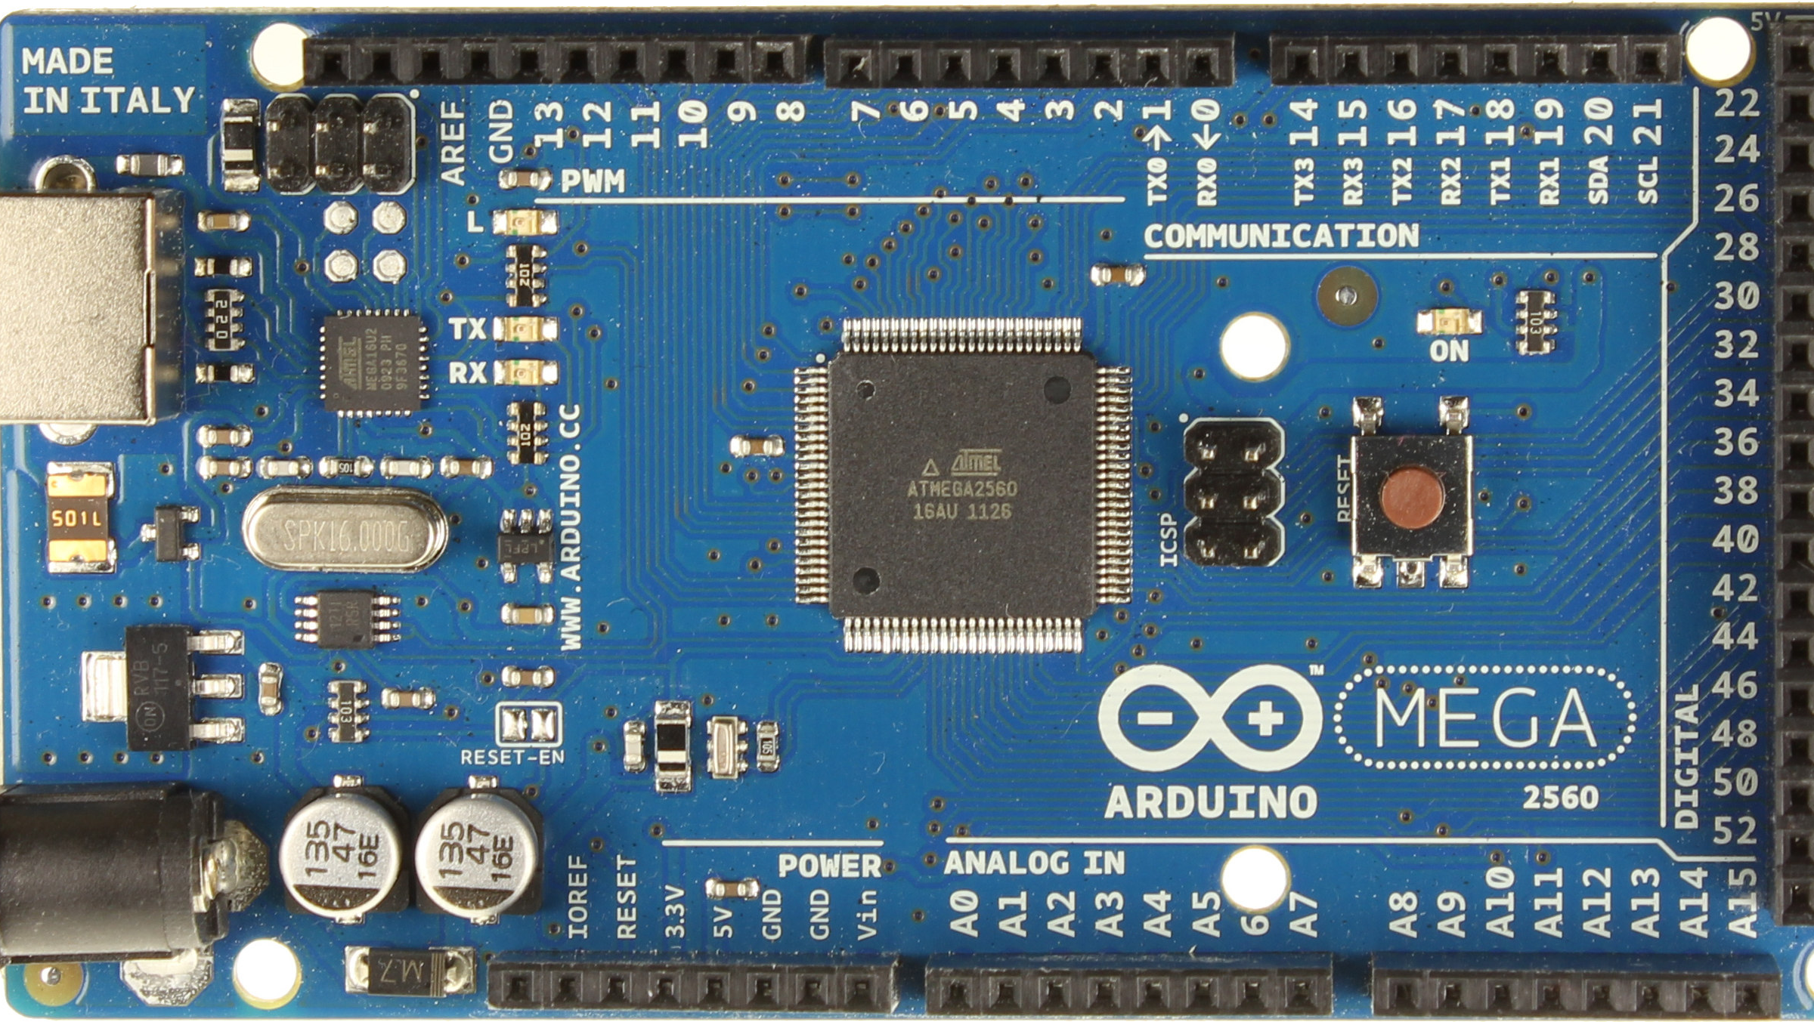
ARDUINO MEGA
Used as a salve device in the project.
Known for its capabilities in handling more complex projects, the Arduino Mega 2560 gives your projects plenty of room and opportunities. It’s recommended for 3D printers and robotics projects with its 54 digital I/O pins, 16 analog inputs, and a large space.
This Photo by Unknown Author is licensed under CC BY-SA-NC

Slide 11
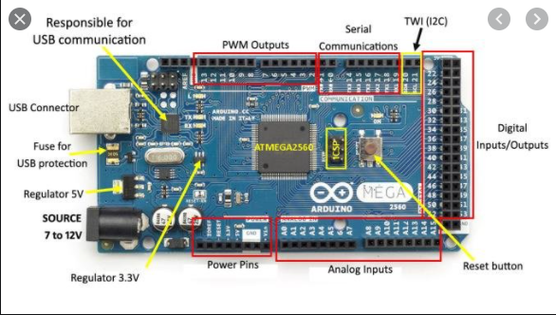
Arduino Mega

Slide 12
INTERFACING OF ARDUINO MEGA WITH BEAGLEBONE BLACK
BEAGLEBONE | ARDUINO
P9 11 | 19 RX1
P9 13 | 18 TX1
GND | GND
Arduino mega is connected to the beaglebone using UART communication protocol.

Slide 13
COMMUNICATION PROTOCOL
Beaglebone and Arduino are communicating with each other by UART communication.
By definition, UART is a hardware communication protocol that uses asynchronous serial communication with configurable speed. Asynchronous means there is no clock signal to synchronize the output bits from the transmitting device going to the receiving end.

Slide 14

UART COMMUNICATION
Arduino Mega has 4 UART Ports available, and we are using SERIAL 1 to perform the communication.
The Serial port 1 has pin 18- TX and Pin 19- RX.
These pins are connected to the Arduino to make the UART communication possible.

Slide 15
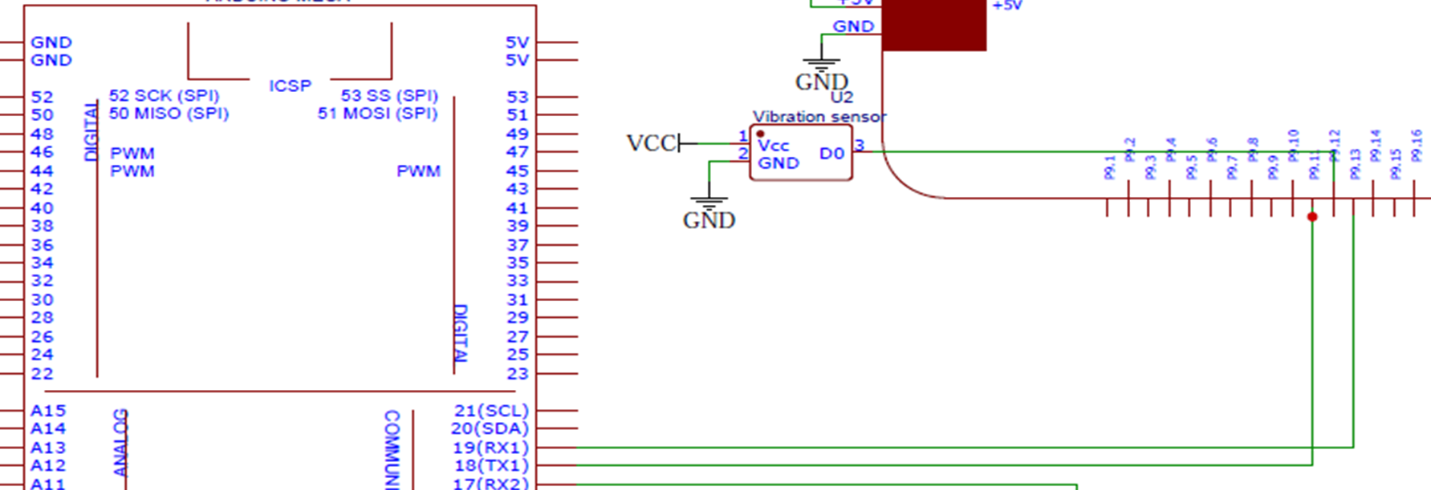
SCHEMATIC DIAGRAM

Slide 16
INTERFACING OF ARDUINO MEGA WITH BEAGLEBONE BLACK

Slide 17
ENABLING THE UART PORT 4 OF BEAGLEBONE BLACK
We need to follow few steps to accomplish this task.
Make a file under the name setTty.sh.
Command used at the terminal is :
nano /usr/local/sbin/setTty.sh
In this file bash script is written to configure the ports on the beaglebone side.

Slide 18
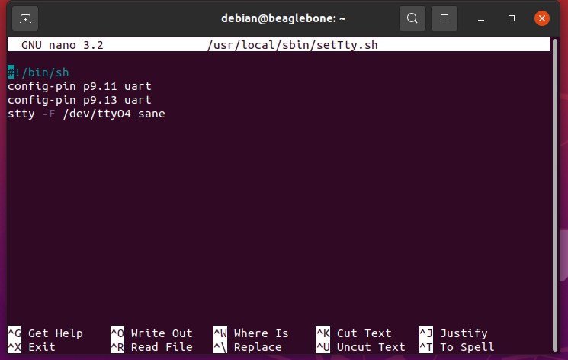
ENABLING THE UART PORT
After saving the file next step is to make this file executable that can be done by the following command on the terminal.
chmod 755 /usr/local/sbin/setTty.sh

Slide 19
ENABLING THE UART PORT 4 OF BEAGLEBONE BLACK
Create a new file with the name testTty.sh.
Open the text editor with the sudo nano command.
nano /usr/local/sbin/testTty.sh.
Similarly make this file also executable like the last one.
chmod 755 /usr/local/sbin/testTty.sh.

Slide 20
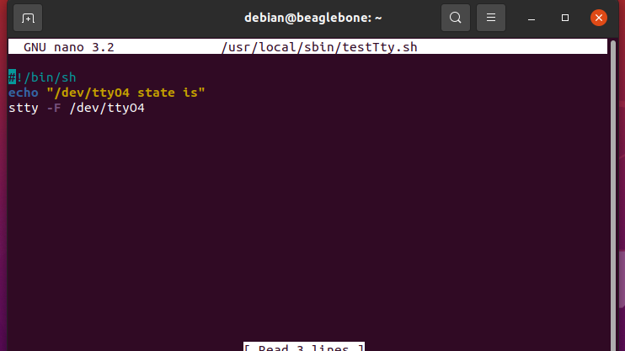
ENABLING THE UART PORT 4 OF BEAGLEBONE BLACK

Slide 21
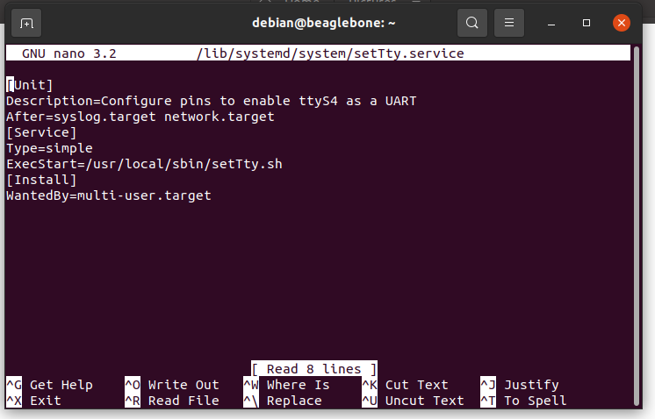
ENABLING THE UART PORT 4 OF BEAGLEBONE BLACK
Create the service configuration file that makes the system run it on startup
Command used : nano /lib/systemd/system/setTty.service.

Slide 22

LIBRARIES INCLUDED
stdio.h
Standard C input Output Library.
unistd.h
defines miscellaneous symbolic constants and types, and declares miscellaneous functions.
string.h
C Library for various String Operations.
termios.h
Contains the definitions used by the terminal I/O interfaces.
fcntl.h // FIle control, Open, close.
time.h The Time library provides the data structures and functions required to retrieve the system time, perform time calculations, and output formatted strings that allow the time to be displayed in a variety of common formats.

Slide 23
LIBRARIES INCLUDED
fcntl.h
FIle control, Open, close.
time.h
The Time library provides the data structures and functions required to retrieve the system time, perform time calculations, and output formatted strings that allow the time to be displayed in a variety of common formats.

Slide 24
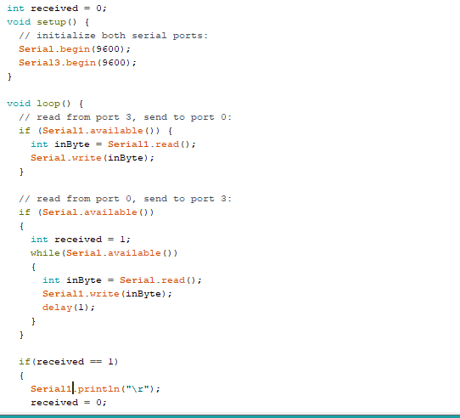
CODE FOR ARDUINO

Slide 25
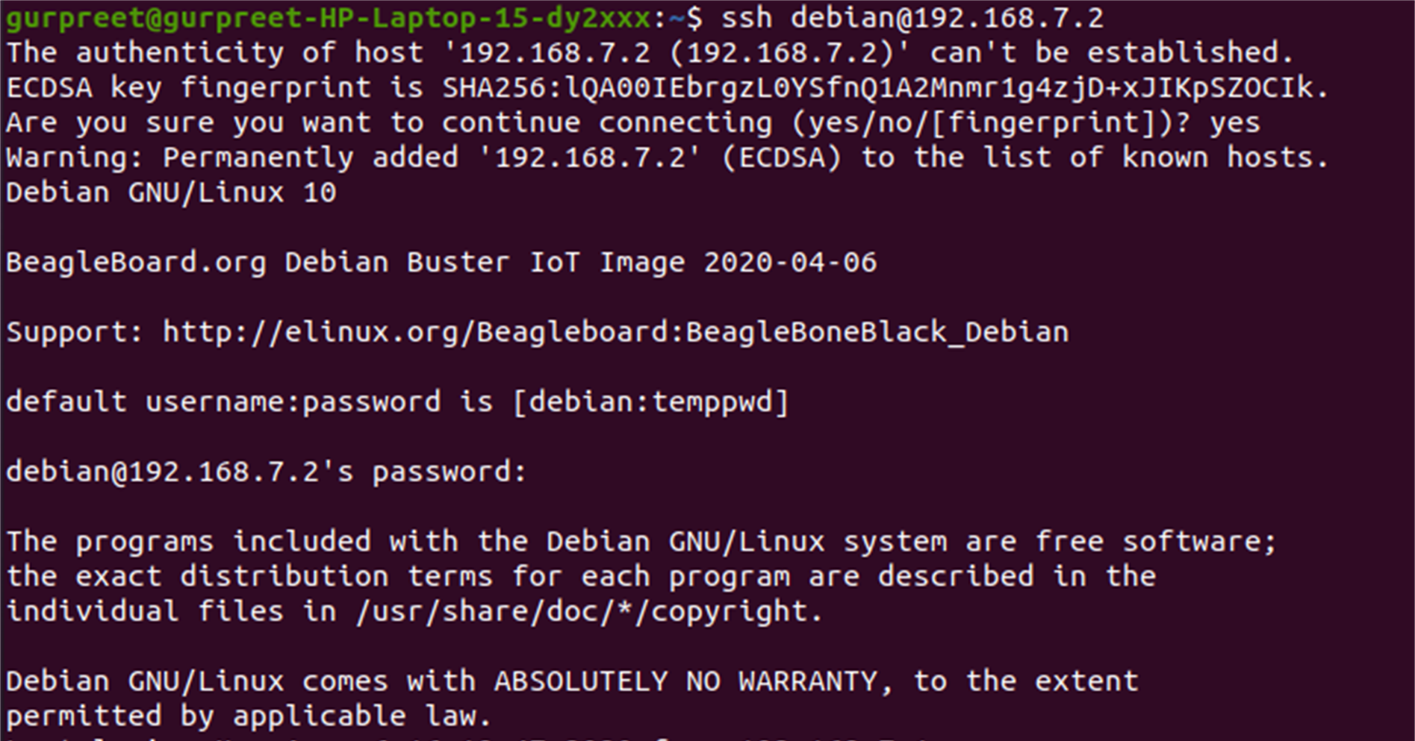

TERMINAL COMMANDS
Enter the command “ssh debian@192.168.7.2” here ssh command instruct the system to establish an encrypted secure connection with the host machine. Debian here represent the user_name that is being accessed on the host and then it is followed by an IP address.
Before continue to next step, the password “temppwd” must be entered.
ENTER PASSWORD HERE

Slide 26
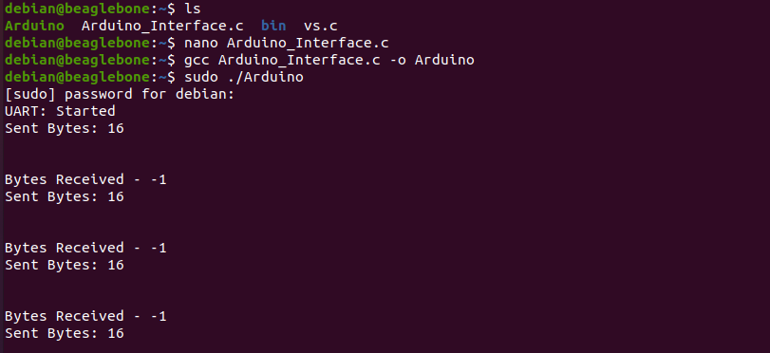
TERMINAL COMMANDS
Enter “ls” to list the files.
To compile and execute the code, enter the command “gcc Arduino_Interface.c -o Arduino.” Here Arduino_Interface.c is the program_name and Arduino is the executable file name. Afterwards, press Enter and write the Executable_name : “sudo ./ Arduino.”
Again, enter the password: temppwd
For compilation and execution

Slide 27
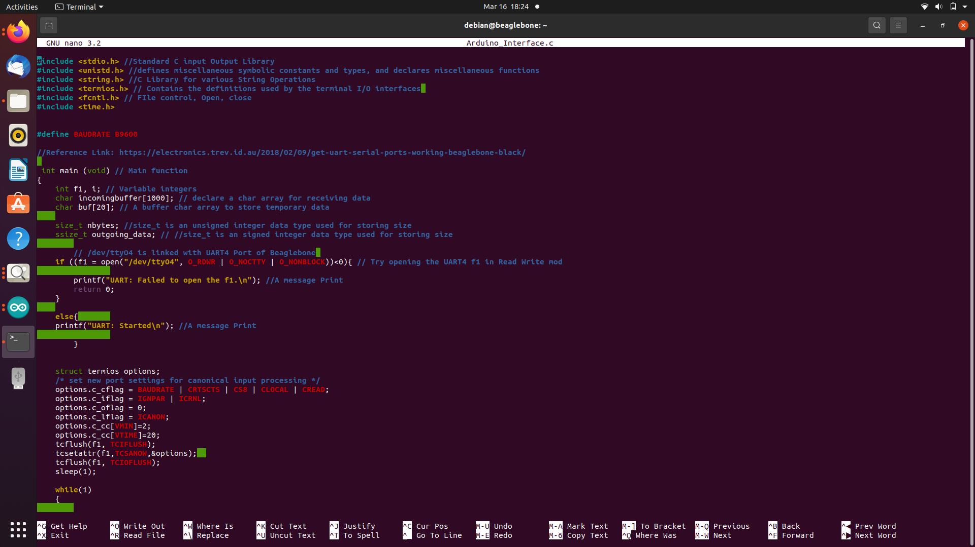
CODING OF ARDUINO INTERFACING

Slide 28
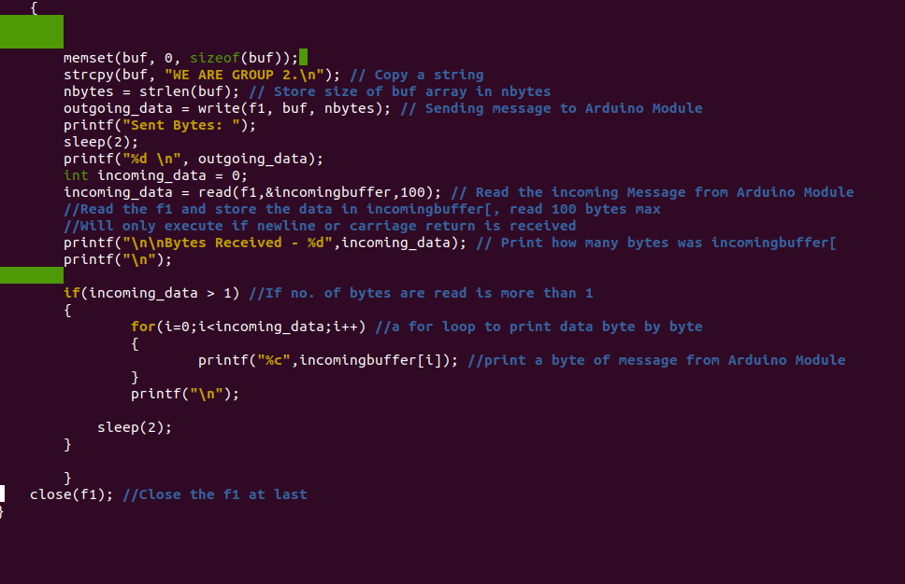
CODING OF ARDUINO INTERFACING

Slide 29
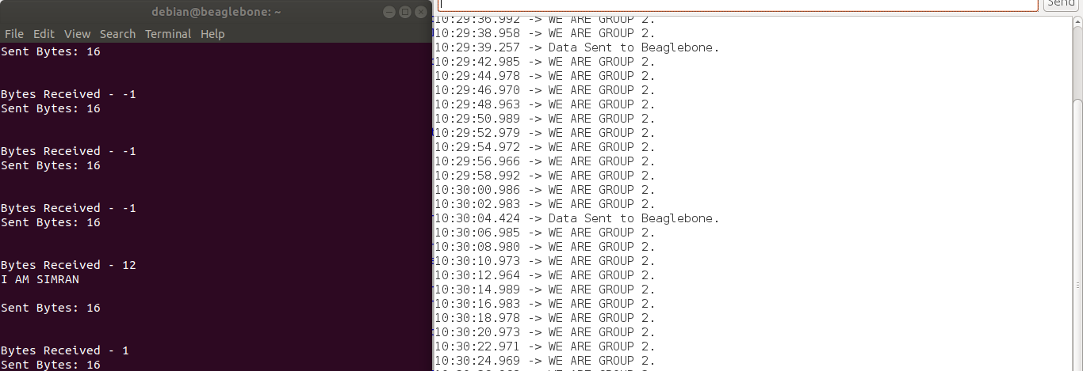
TERMINAL OUTPUT

Slide 30
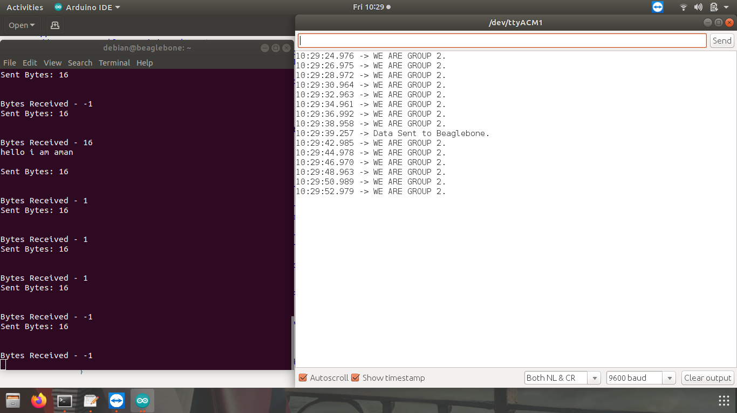
TERMINAL OUTPUT

Slide 31
REFERENCES
https://electronics.trev.id.au/2018/02/09/get-uart-serial-ports-working-beaglebone-black.
https://stackoverflow.com/questions/6947413/how-to-open-read-and-write-from-serial-port-in-c.
https://www.wikitechy.com/tutorials/linux/how-to-open-read-and-write-from-serial-port-in-c.
Tutorial - Running the Arduino IDE on the BeagleBone Black (onlogic.com)
https://www.youtube.com/watch?v=LubYc87S9tQ&ab_channel=BINARYUPDATES

